Slide 1

Intrusion Detection System using Deep Learning

Slide 2
Team Names:
Samir Waleed Samir
Ahmed Fawzy
Ahmed Gamal
Omar Hamed
Ahmed Ezzat
Fayrouz Eslam
Basant Emad
Amira Assim

Slide 3

Introduction to Intrusion Detection Systems
Intrusion detection systems (IDS) are designed to detect malicious activity on a computer network. They analyze network traffic and system events to identify patterns indicative of intrusions. Traditional IDS approaches rely on predefined rules and signatures, but these methods struggle to keep up with evolving threats.

Slide 4

Challenges in Traditional IDS Approaches
Traditional IDS methods are often limited by their reliance on predefined rules. They struggle to detect novel attacks and are vulnerable to evasion techniques. Their signature-based nature makes them inefficient against polymorphic malware and zero-day exploits.

Slide 5
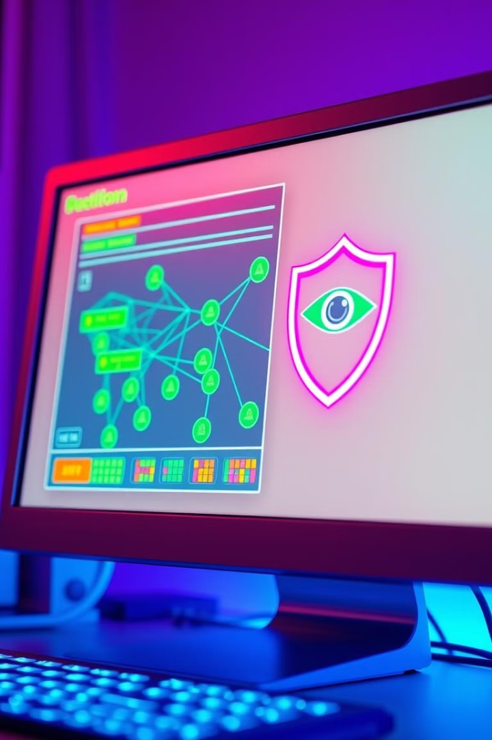
Motivation for Deep Learning in IDS
Deep learning offers a promising solution to the challenges of traditional IDS. Its ability to learn complex patterns from large datasets allows for more robust and adaptable intrusion detection. Deep learning models can learn from historical data and adapt to new threats without requiring constant rule updates.

Slide 6




Model 1: URL Anomaly Detection
Data Collection
Feature Engineering
Model Training
Real-Time Detection
Collect a vast dataset of URLs, benign: 0 defacement: 1, phishing: 2, malware: 3
Train an ANN model to identify anomalies in URL features.
Extract relevant features from URLs, such as length, domain name, TLD, suspicious Words.
Deploy the trained model to detect malicious URLs in real-time.

Slide 7



Model 2: Network Traffic Analysis
Collects network traffic data from various sources like firewalls, intrusion detection systems, and network taps.
Leverages cloud platforms like AWS for data storage, processing, and model deployment.
Analyzes network traffic patterns, identifying anomalies and potential threats using deep learning models.

Slide 8

Model 3: Cloud Infrastructure Monitoring
Log Analysis
Security Groups
Monitors AWS CloudTrail logs for suspicious activity, including API calls, resource changes, and user login attempts.
Analyzes AWS security group rules to identify potential vulnerabilities and unauthorized access.

Slide 9
Model 1: URL Anomaly Detection
Objective
Method
To identify malicious URLs by analyzing their characteristics, such as domain name, path, and query parameters.
We used a artificial neural network (ANN) to learn patterns in URLs and classify them as benign or malicious.

Slide 10
Model 2: Network Traffic Analysis
Objective
Method
To analyze network traffic data and identify patterns indicative of intrusion attempts, such as abnormal traffic volume, unexpected connection requests, and unusual data packets.
We used a LSTM model to extract features from network traffic data and train a classifier to detect intrusions.

Slide 11
Model 3: Cloud Infrastructure Monitoring
Objective
Method
To monitor cloud infrastructure for suspicious activity, such as unauthorized access, resource abuse, and data breaches.
We used a long artificial neural network (ANN) network to analyze cloud logs and identify anomalies indicative of security incidents.

Slide 12

Evaluation and Comparison of Models
The models were evaluated on a variety of metrics, including accuracy, precision, recall, and F1-score. The results demonstrated the effectiveness of deep learning for intrusion detection, with models achieving high detection rates and low false positive rates.

Slide 13

Deployment Considerations
Deployment of the intrusion detection system involves considerations for scalability, integration with existing security infrastructure, and ongoing monitoring and maintenance.

Slide 14

Conclusion and Future Directions
The use of deep learning offers significant advantages for intrusion detection systems. Future directions include exploring more advanced deep learning architectures, developing new intrusion detection techniques, and integrating the system with other security solutions.

Slide 15
Thanks Eng. Omar Elnahas

